Slide 1


SIMATS ENGINEERING
SAVEETHA INSTITUTE OF MEDICAL AND TECHNICAL SCIENCES
Manual Test Case Generation and Bug Reporting System for Online Hotel Booking System
CSA3717 – Software Testing
Presented by:
B. Thejaswini[192412479]
Anchal Kumari[192312255]
M. Sandhya[192312421]
B. Bhavana[192312428]
Guided by:
Dr. Krishna raj Mony
Associate Professor/CSE

Slide 2


INTRODUCTION
Growth of online booking: Customers search rooms, book, pay and cancel online, so even a small defect can cause lost bookings and revenue.
Need for testing: Errors in search, availability, payment or cancellation reduce user trust, so every function must be verified before release.
Manual testing: Testers use the website like a real guest and check each feature by hand to find functional, usability and display problems.
Test case generation: Test cases are designed step by step using Equivalence Partitioning, Boundary Value Analysis and Decision Tables.
Bug reporting: Every defect is recorded with steps to reproduce, expected and actual result, severity and priority, then tracked until it is closed.

Slide 3
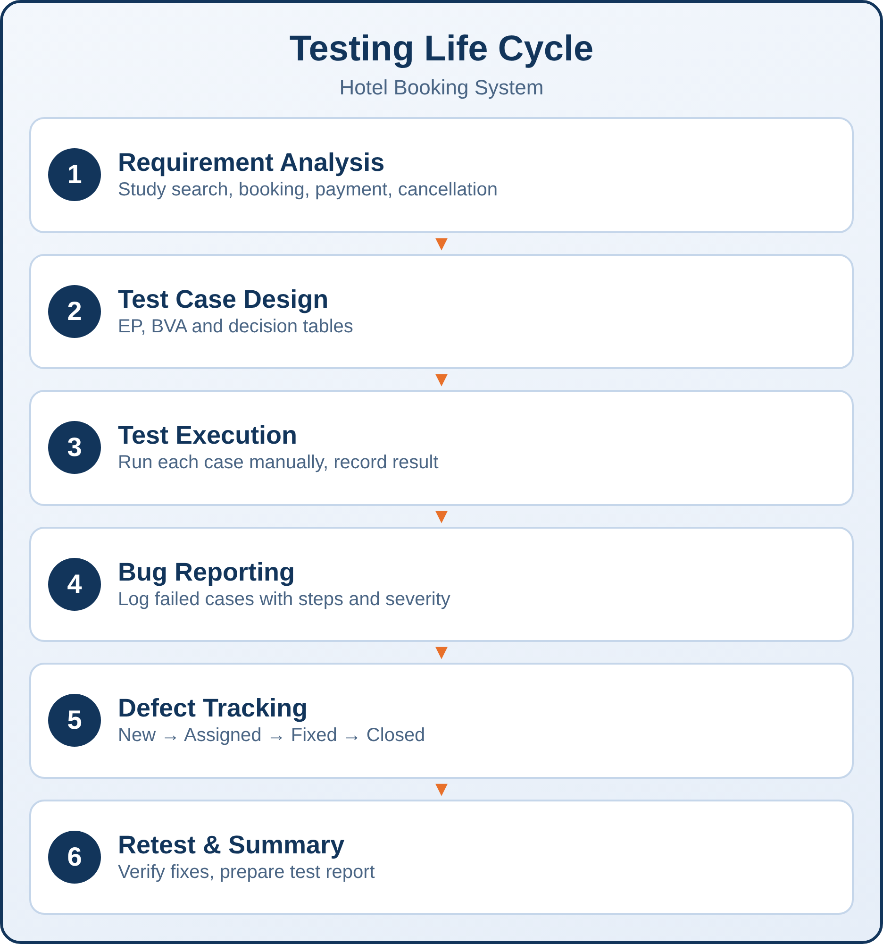
OBJECTIVES
Requirement Analysis: Study the hotel booking requirements such as login, search, booking, payment and cancellation.
Test Case Design: Create clear and complete test cases using standard design techniques and a fixed template.
Test Execution: Run the test cases manually and compare actual results with expected results.
Bug Reporting: Report each failed case with steps, severity, priority and screenshots so developers can fix it quickly.
Defect Tracking & Analysis: Track defects from New to Closed, retest the fixes and prepare a test summary report.

Slide 4
LITERATURE SURVEY
S.No | Title | Authors | Year | Techniques Used | Problem Addressed
1 | What Makes a Good Bug Report? | T. Zimmermann, R. Premraj, N. Bettenburg, S. Just, A. Schröter, C. Weiss | 2010 | Developer survey, CUEZILLA bug report quality scoring | Bug reports often miss steps to reproduce and other details developers need
2 | Model Based Testing Approach for Tourism Applications: Use Case Scenarios for Booking Accommodations | E. B. Giritli, Y. S. Can, A. Sen, F. Alagöz | 2024 | Model-based testing, GraphWalker, Selenium | Reliability of the booking journey: login, hotel search, reservation and payment
3 | Hotel Reservation Application Testing at LeGreen Hotel & Suite using Black Box Boundary Value Analysis | A. Yani, D. Setiawan, N. E. Sofian, R. Subagja, T. Desyani | 2020 | Black box testing, Boundary Value Analysis | Verifying hotel reservation functions; faults found in admin login and print report
4 | The Art of Software Testing, 3rd ed. | G. J. Myers, C. Sandler, T. Badgett | 2011 | Equivalence partitioning, boundary value analysis, cause-effect | Need for systematic design of effective test cases
5 | Certified Tester Foundation Level Syllabus v4.0 | ISTQB | 2023 | Test design techniques, defect management | Common terms and practice for test design and defect reporting

Slide 5
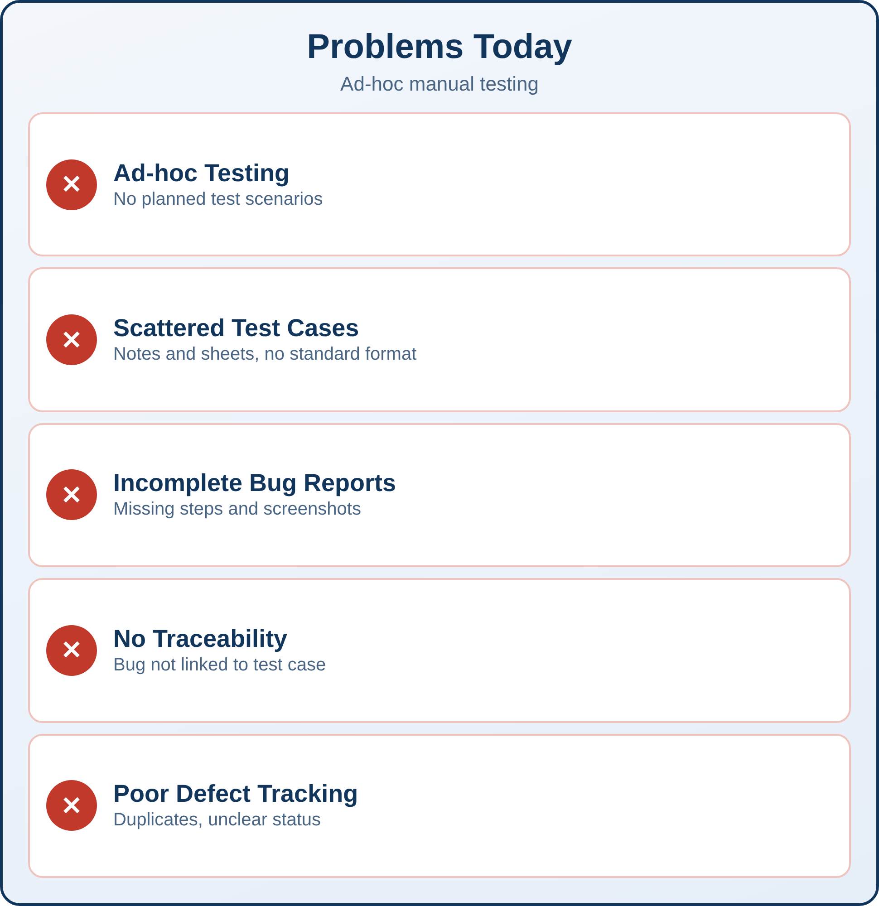
EXISTING SYSTEM
Ad-hoc Testing: Testing is done without a plan, so important scenarios are often missed.
Scattered Test Cases: Test cases are kept in notes or different sheets with no standard format.
Incomplete Bug Reports: Reports often miss steps to reproduce, test data or screenshots, so developers cannot repeat the bug.
No Traceability: Bugs are not linked to the requirement or test case that found them.
Poor Defect Tracking: Duplicate bugs and unclear status make it hard to know what is fixed.

Slide 6
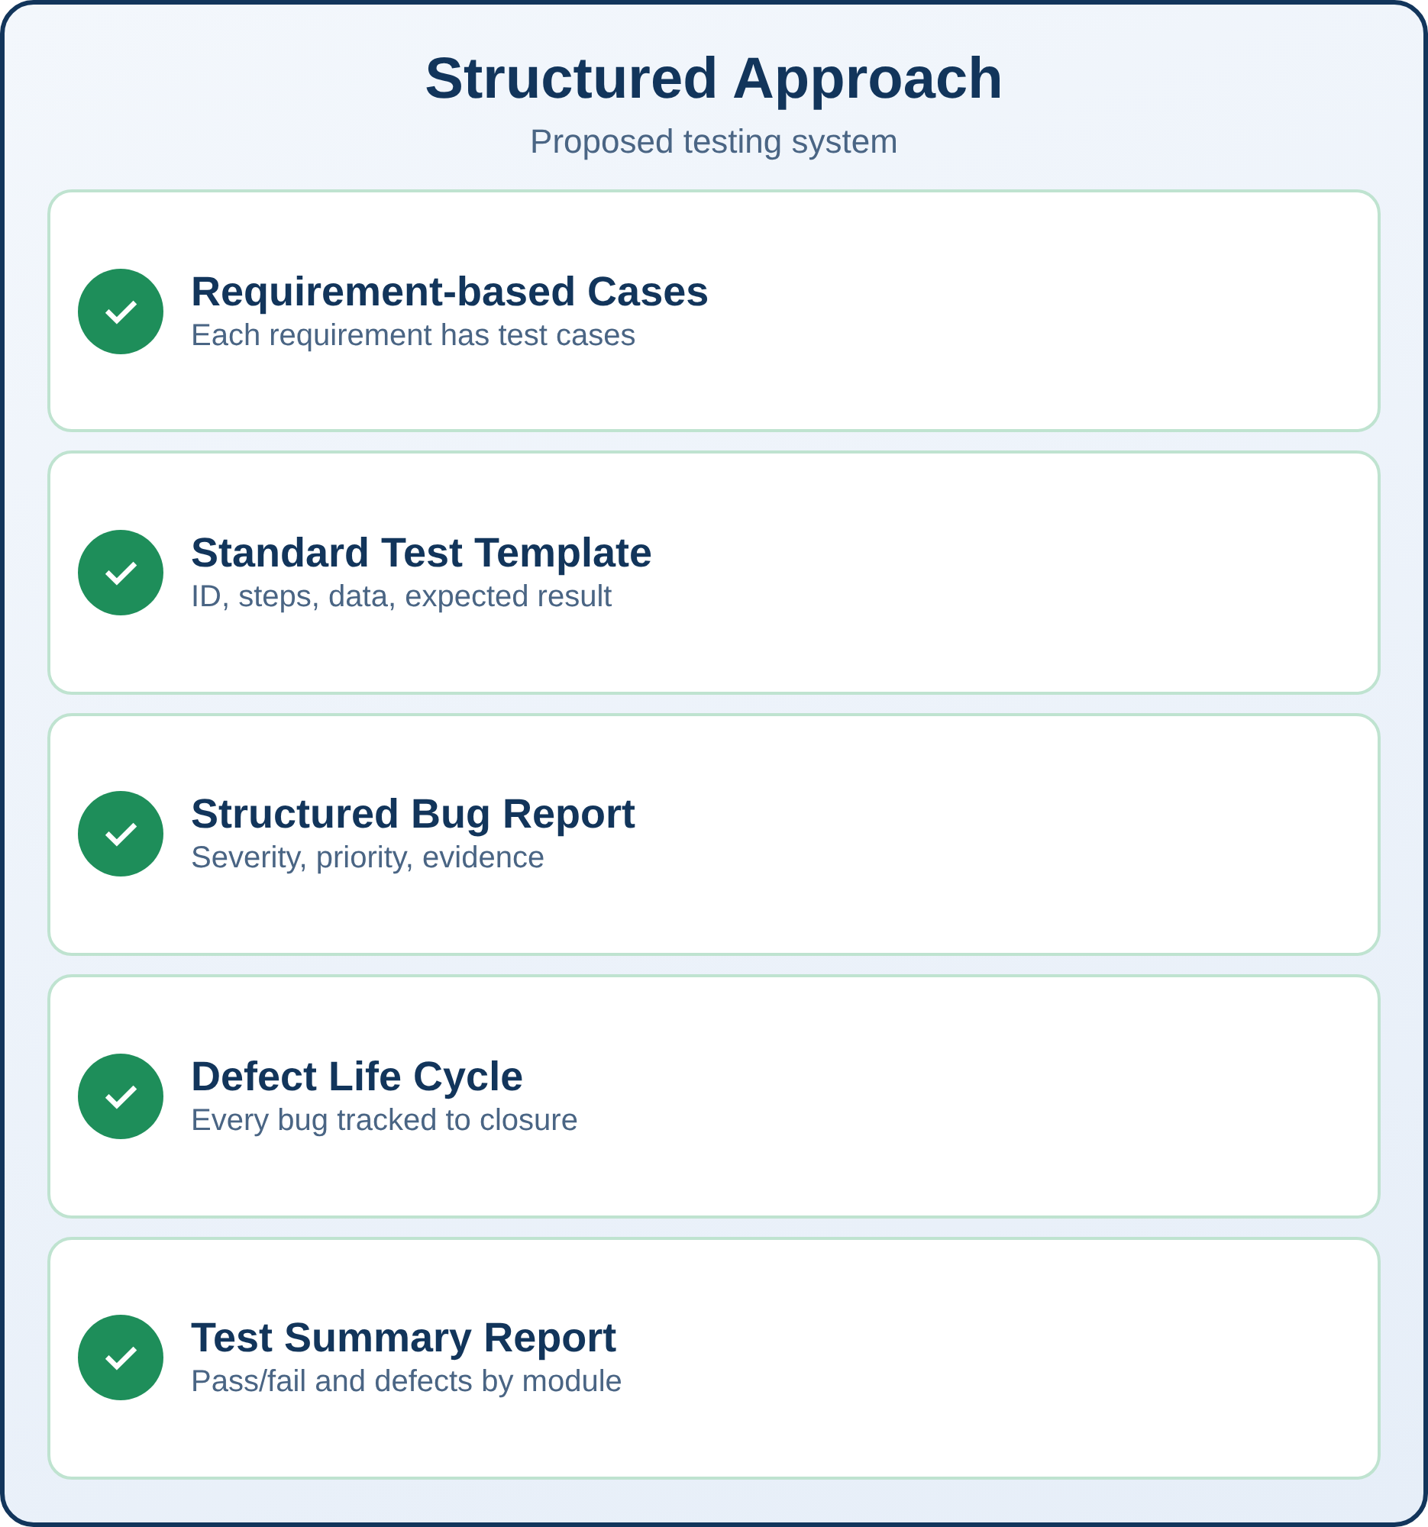
PROPOSED SYSTEM
Requirement-based Test Cases: Every requirement of the hotel system gets test cases built with EP, BVA and decision tables.
Standard Test Case Template: Each case has ID, module, precondition, steps, test data, expected result, actual result and status.
Structured Bug Report: A fixed format with summary, steps, severity, priority, environment and evidence.
Defect Life Cycle: Each bug moves through New, Assigned, Fixed, Retest and Closed, or Reopened if it fails again.
Test Summary Report: Shows passed and failed cases and defects by module and severity to support release decisions.

Slide 7
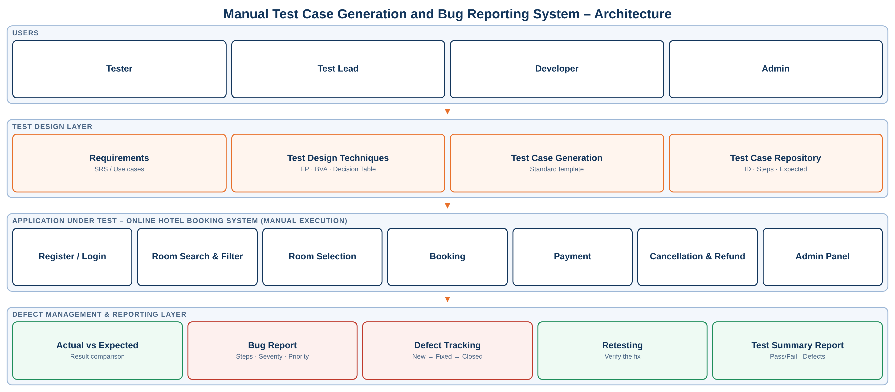
ARCHITECTURE DIAGRAM

Slide 8
SAMPLE TEST CASES
TC ID | Module | Test Scenario | Test Data | Expected Result | Status
TC_01 | Login | Login with valid email and password | Email: user@test.com, valid password | User logs in and lands on home page | Pass
TC_02 | Search | Search hotels with check-out date before check-in date | Check-in 10-Nov, check-out 08-Nov | Error: check-out must be after check-in | Pass
TC_03 | Booking | Book a room for the maximum allowed guests (BVA) | Guests = 4 (max), 5 (above max) | 4 accepted; 5 shows error message | Fail
TC_04 | Payment | Pay using a card with insufficient balance | Valid card, balance below amount | Payment declined; booking not confirmed | Pass
TC_05 | Cancellation | Cancel a confirmed booking before the deadline | Booking ID of confirmed booking | Booking cancelled; refund message shown | Pass

Slide 9
SAMPLE BUG REPORTS
Bug ID | Module | Summary | Steps to Reproduce | Severity / Priority | Status
BUG_01 | Booking (TC_03) | System accepts 5 guests when maximum is 4 | 1. Search a room 2. Select 5 guests 3. Click Book Now | Medium / High | New
BUG_02 | Payment | Booking confirmed even though payment failed | 1. Choose room 2. Enter declined card 3. Submit | High / High | Assigned
BUG_03 | Search | Price filter shows rooms above the selected maximum | 1. Open search 2. Set max price 3,000 3. Apply filter | Medium / Medium | Fixed
BUG_04 | Home page | Logo overlaps menu on small screens | 1. Open site on mobile 2. View home page | Low / Low | Closed

Slide 10
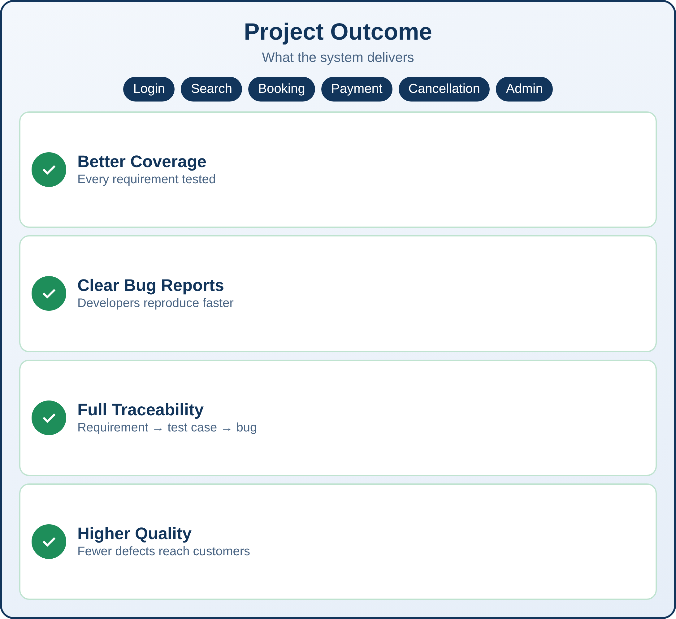
CONCLUSION
This project presents a manual testing system for an online hotel booking website. It designs test cases for login, search, booking, payment and cancellation, executes them by hand, and records every defect in a standard bug report that is tracked to closure. This improves test coverage, helps developers fix bugs faster and raises the quality of the booking system.

Slide 11
REFERNCES
1. T. Zimmermann, R. Premraj, N. Bettenburg, S. Just, A. Schröter, and C. Weiss, “What Makes a Good Bug Report?,” IEEE Transactions on Software Engineering, vol. 36, no. 5, pp. 618–643, 2010.
2. E. B. Giritli, Y. S. Can, A. Sen, and F. Alagöz, “Model Based Testing Approach for Tourism Applications: Use Case Scenarios for Booking Accommodations,” Computer Science & Information Technology (CS & IT), pp. 57–64, 2024. DOI: 10.5121/csit.2024.142006.
3. A. Yani, D. Setiawan, N. E. Sofian, R. Subagja, and T. Desyani, “Pengujian Aplikasi Reservasi Hotel di LeGreen Hotel & Suite dengan Metode Black Box Testing Boundary Value Analysis,” Jurnal Teknologi Sistem Informasi dan Aplikasi, 2020.
4. G. J. Myers, C. Sandler, and T. Badgett, The Art of Software Testing, 3rd ed. Hoboken, NJ, USA: Wiley, 2011.
5. ISTQB, “Certified Tester Foundation Level Syllabus,” International Software Testing Qualifications Board, v4.0, 2023.

Slide 12
THANK YOU

